Slide 1

CLASSIFICATION PREDICT
Team_SS4_JHB_First_Class
Mangaliso Samuel Makhoba
keabetswe Lefifi
Noxolo Kheswa
netsianda khathutshelo
Ifeoluwapo Oni
Nelisiwe Phiwe Mabanga

Slide 2
TABLE OF CONTENTS
Introduction
Data Preprocessing
Exploratory Data Analysis
Data Cleaning
Feature Engineering
Modelling
Conclusion
References

Slide 3
Introduction
Many companies are built around lessening one’s environmental impact or carbon footprint. They offer products and services that are environmentally friendly and sustainable, in line with their values and ideals.
The main aim for this project is to determine how people perceive climate change and whether or not they believe it is a real threat.
Providing an accurate and robust solution to this task gives companies access to a broad base of consumer sentiment, spanning multiple demographic and geographic categories - thus increasing their insights and informing future marketing strategies.
Problem statement
Build an effective Machine Learning model that is able to classify whether or not a person believes in climate change, based on their novel tweet data.

Slide 4
Import libraries and Datasets
Import all the necessary libraries
Read the datasets that are given

Slide 5
Evaluate Data
Checking info of all data
Checking summary statistics of all data
Checking for missing data
Checking for unique classes in our sentiment
Checking whether a character is white-space character or not

Slide 6
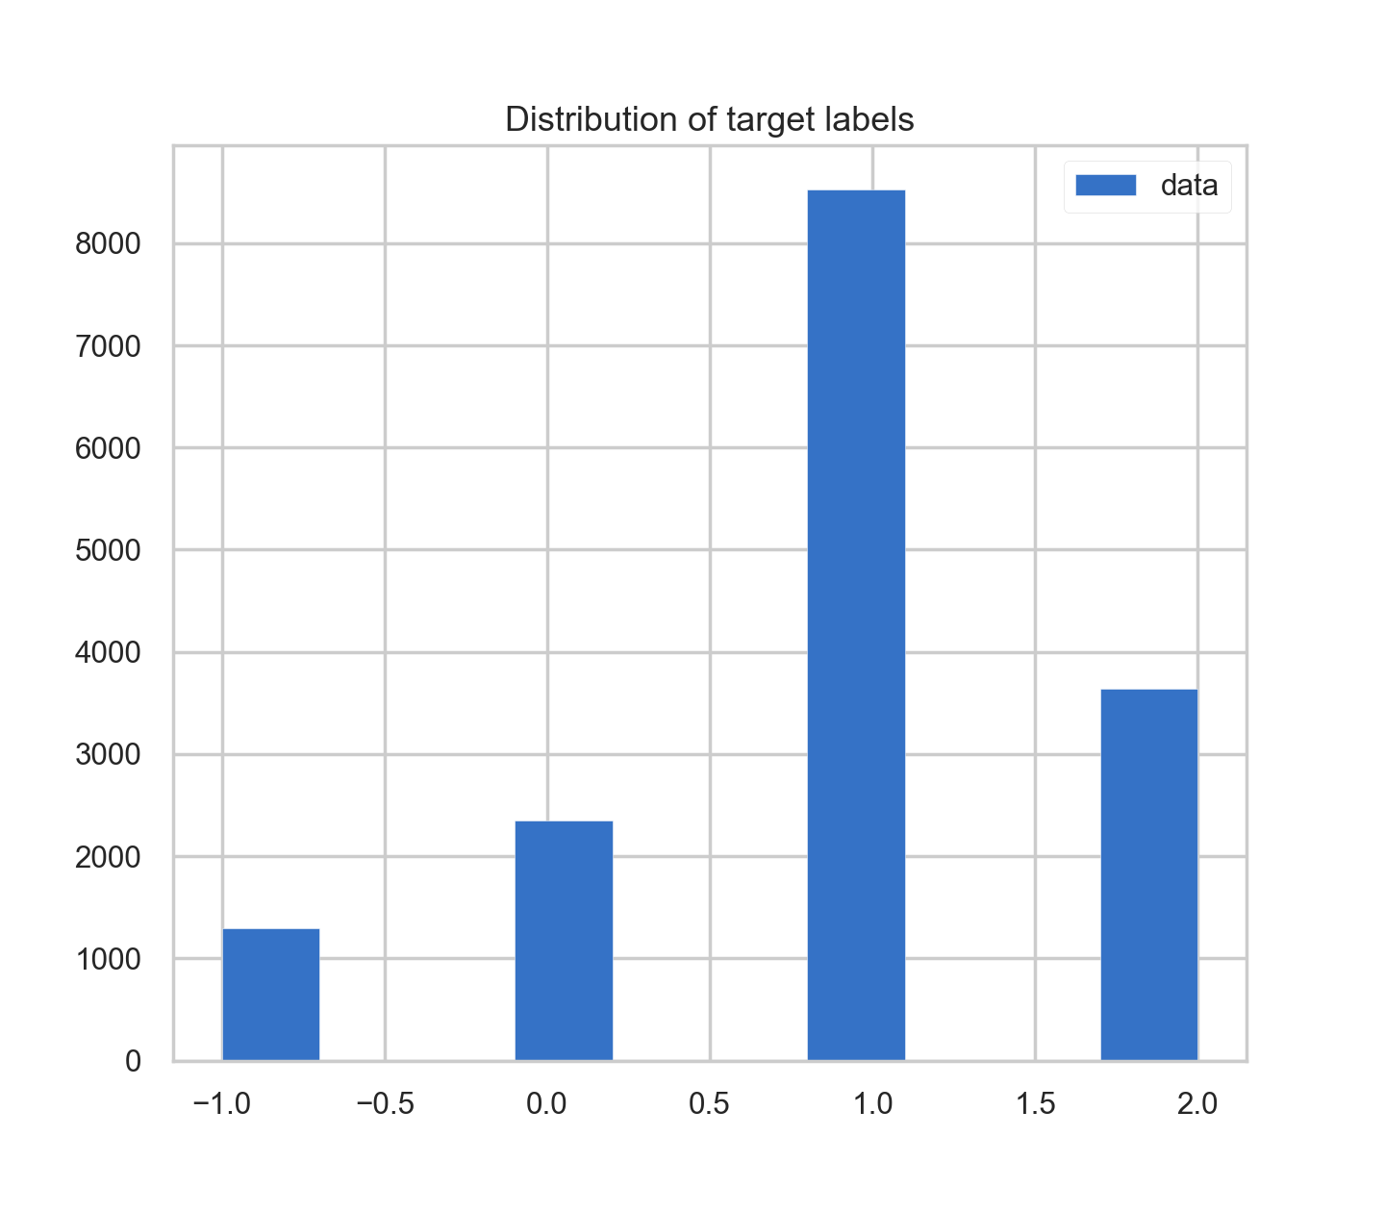
DATA PREPROCESSING
Visualizing the distribution of the target

Slide 7
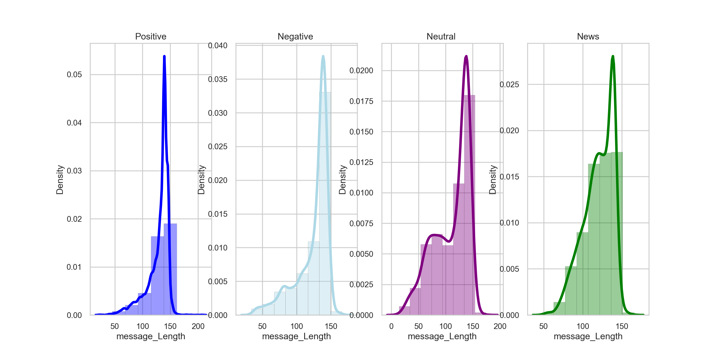
Distribution plots for label

Slide 8
EXPLORATORY DATA ANALYSIS (EDA)
Labeling the target
checking the numerical distribution
Visualizing text lengths for each sentiment
Extracting Users in a column
Generating Counts of users

Slide 9
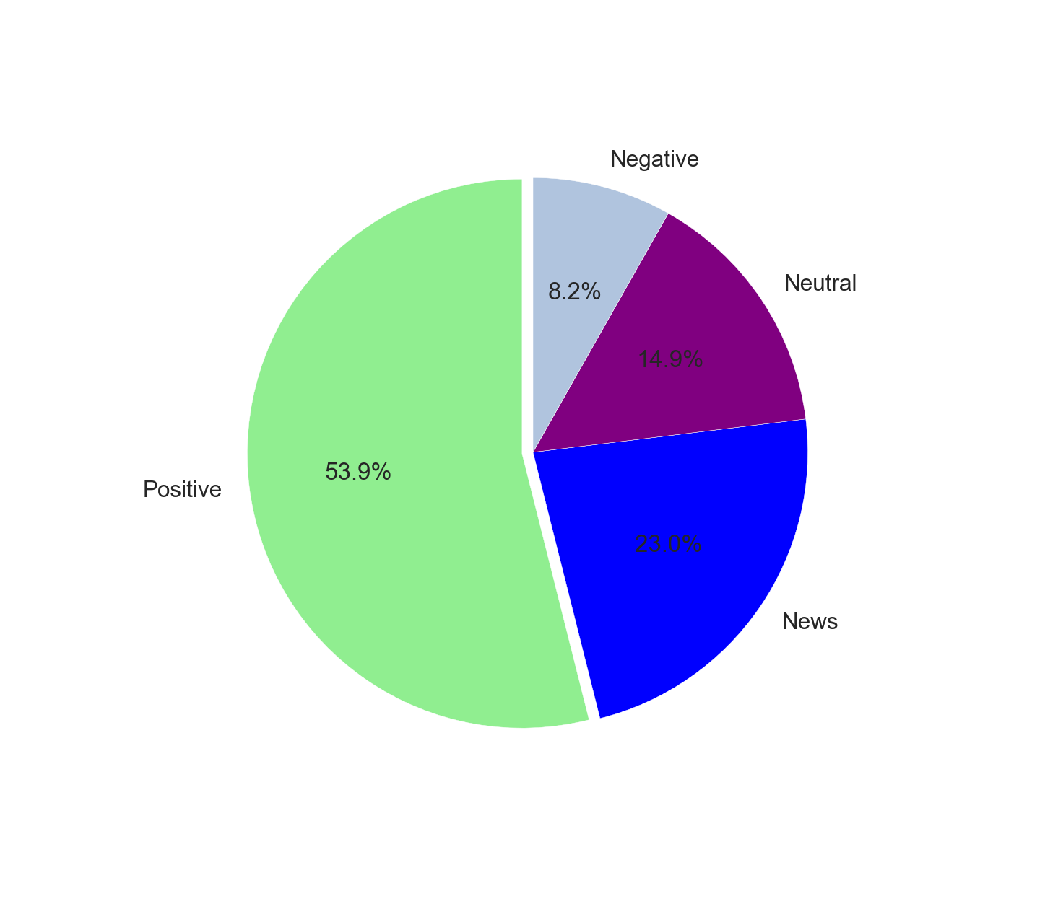
Checking percentage of the numerical distribution

Slide 10
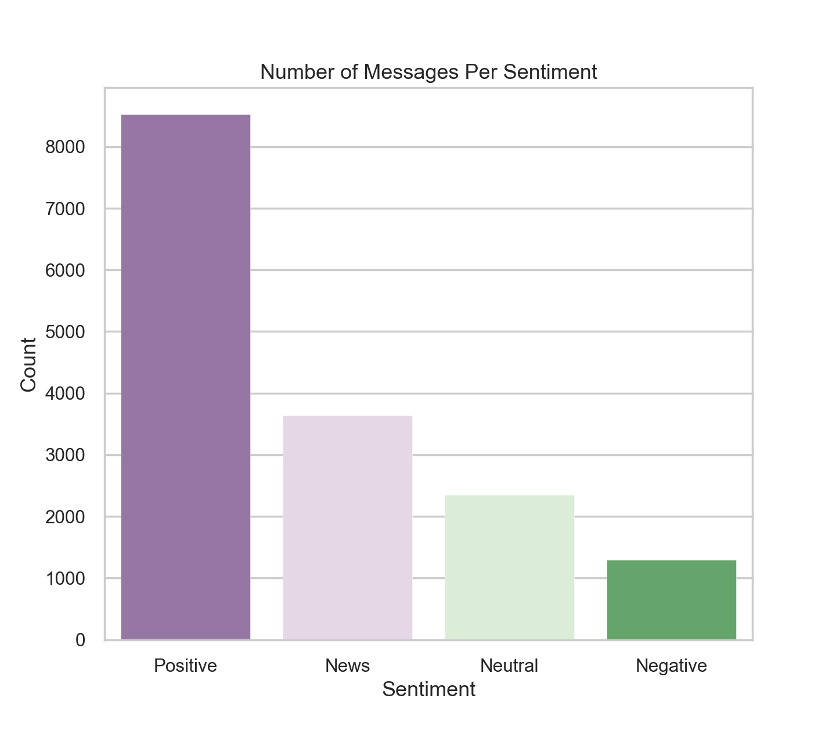

Slide 11
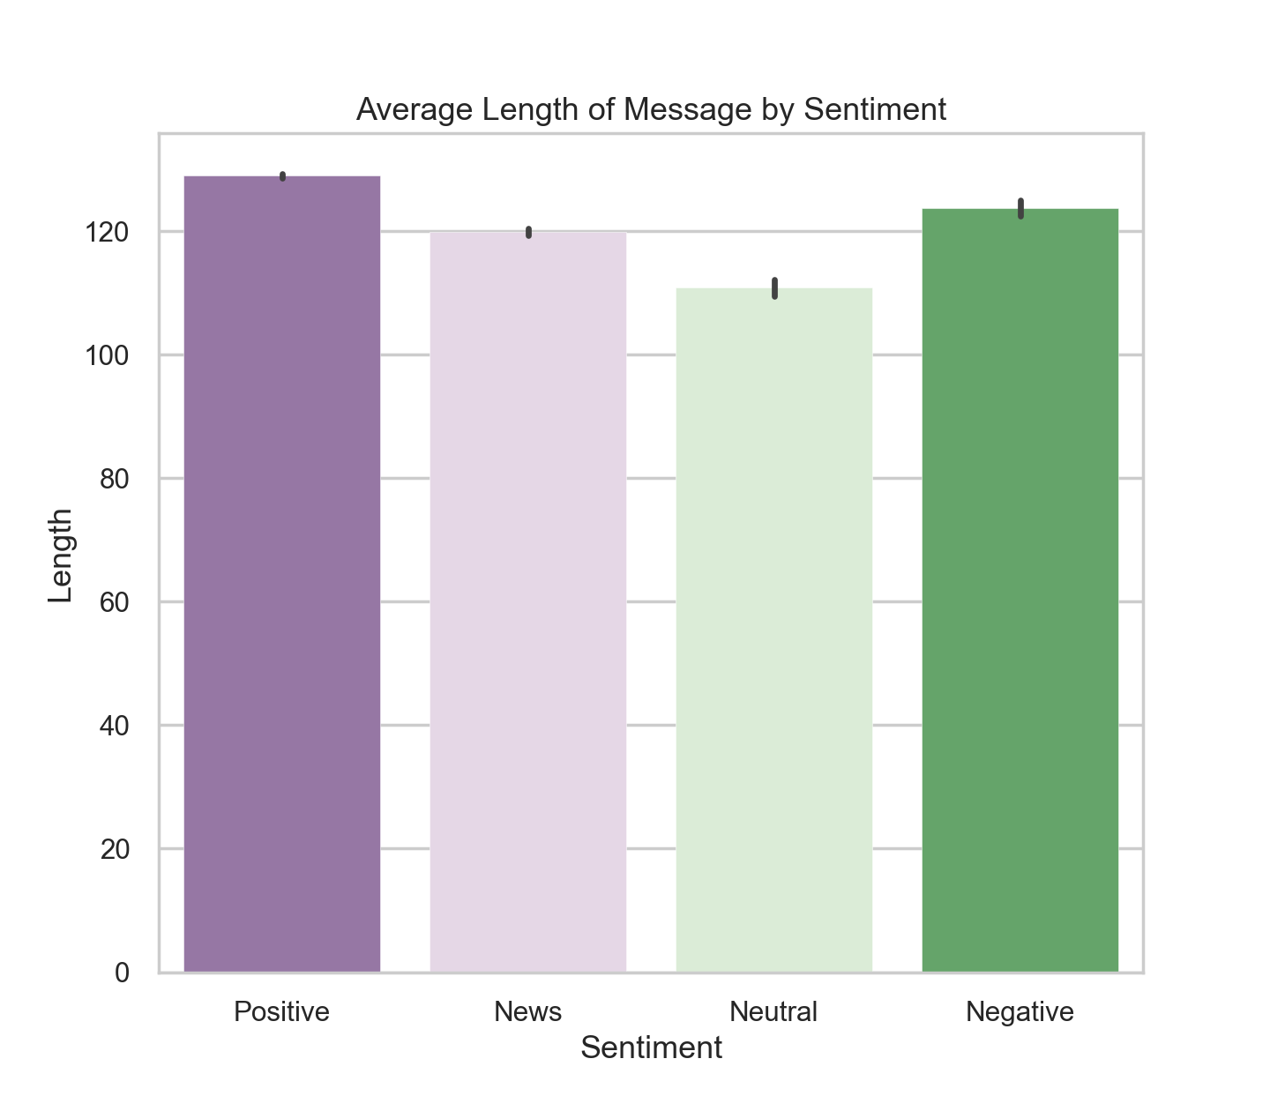
Visualizing text lengths for each sentiment

Slide 12
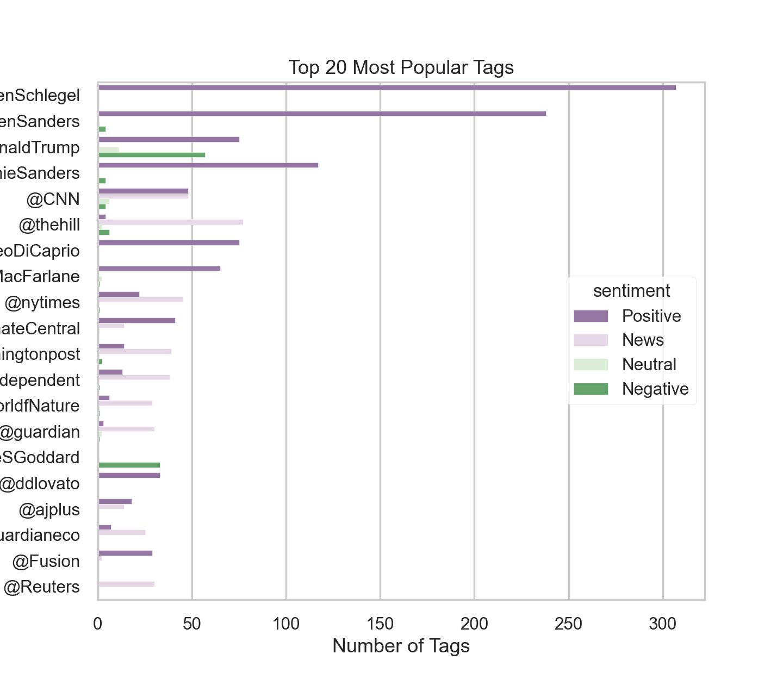
Analysis of most popular tags, sorted by popularity

Slide 13
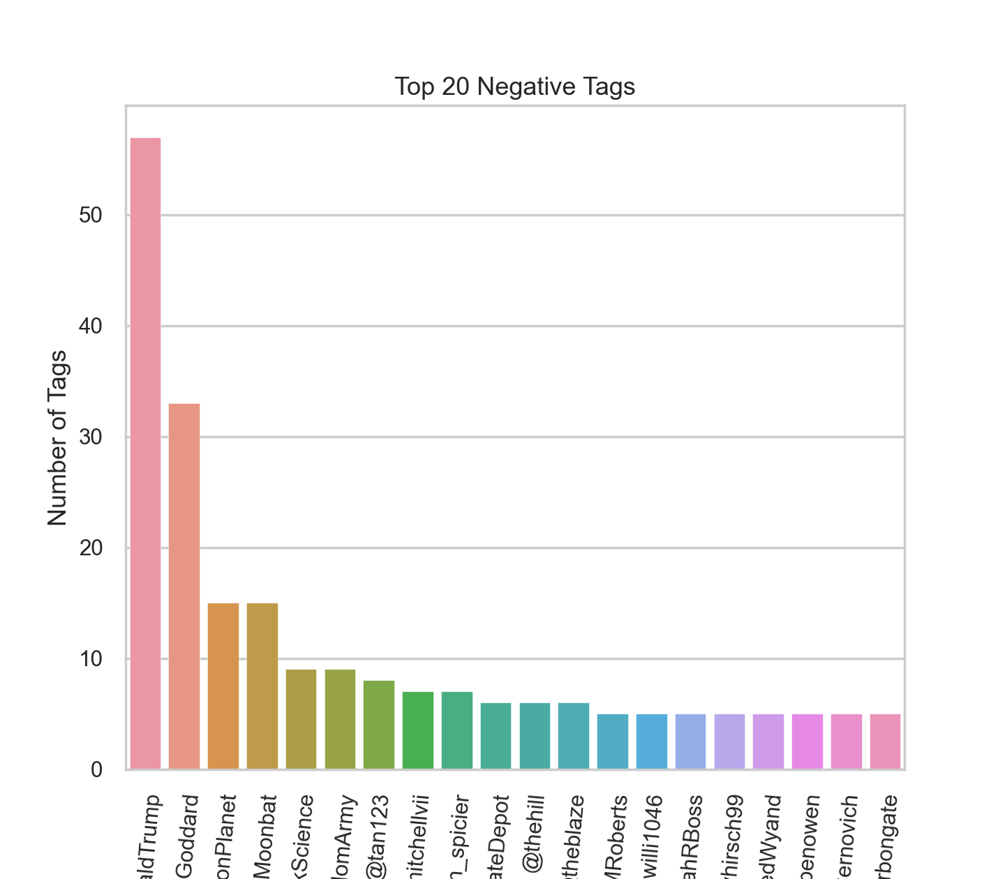
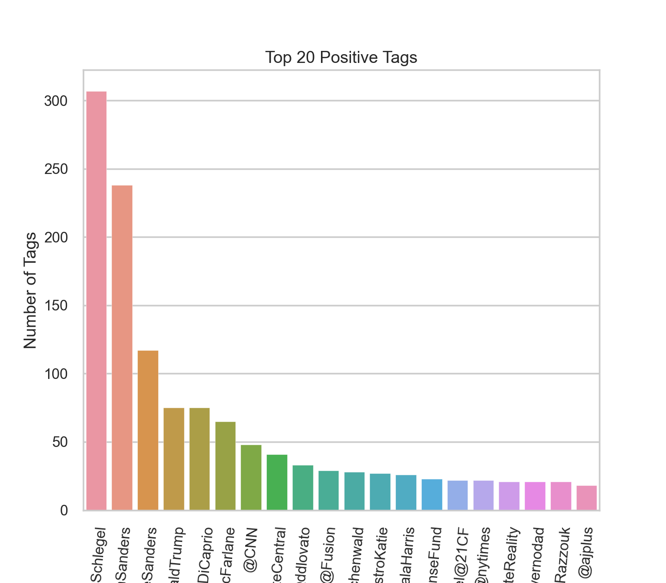
Top 20 positive and negative tags

Slide 14
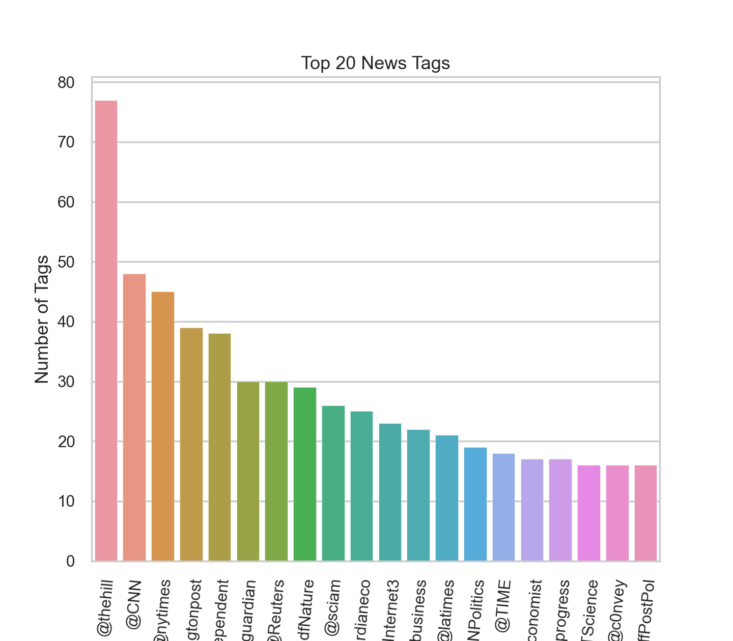
Top 20 news tags

Slide 15
DATA CLEANING
Testing the Porter Stemmer
Testing Lemmatization
Use nlp tool to transform messages into more digestible form
Remove RT, URL and trailing white spaces
Remove stop words and punctuation
Combining all the messages

Slide 16
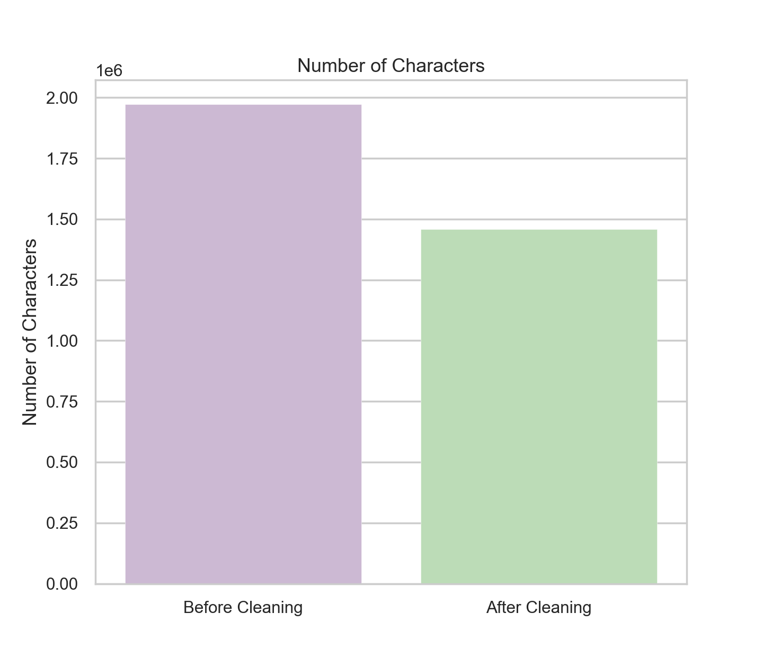
Number of characters before and after cleaning

Slide 17
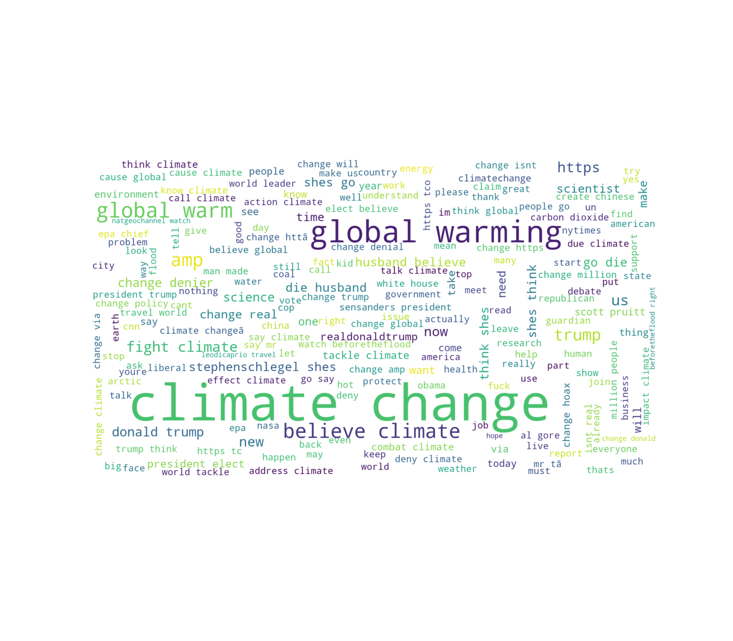
Generating the word cloud image from all the messages

Slide 18
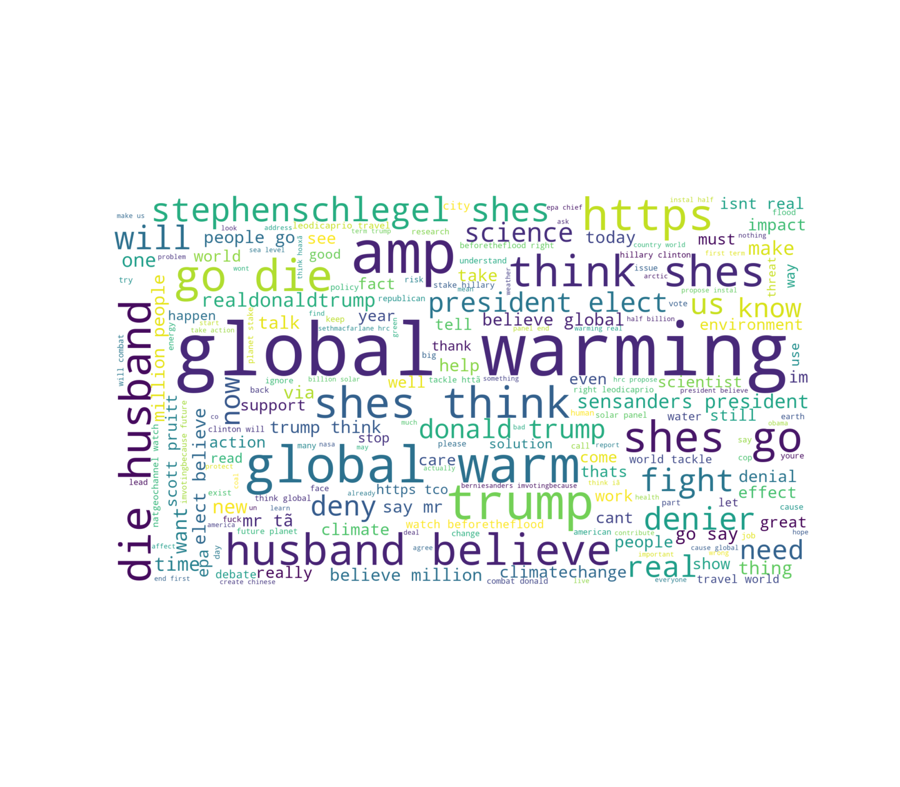
Generating the word cloud image from Positive messages

Slide 19
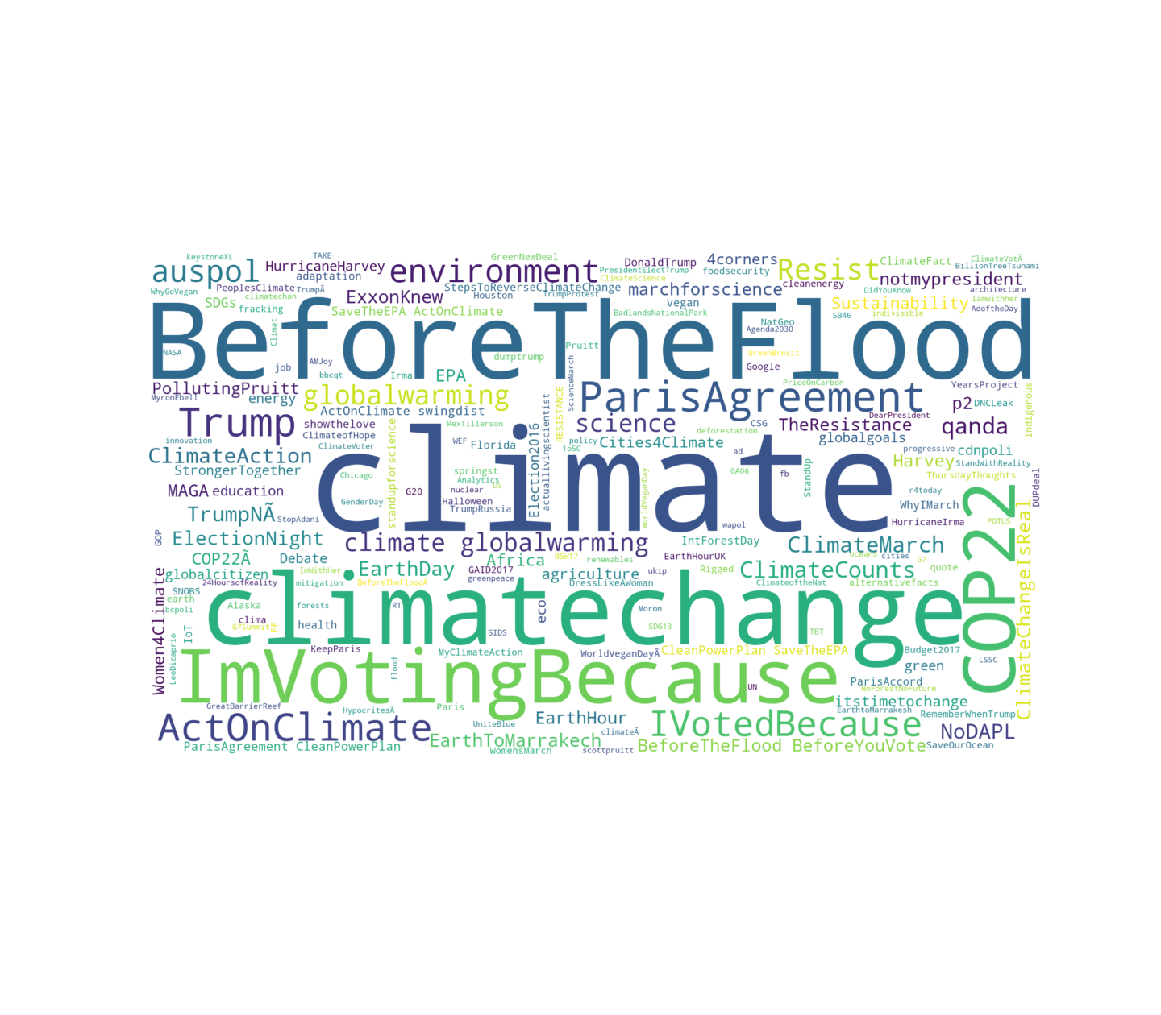
Generating the word cloud image from Positive Hashtags

Slide 20
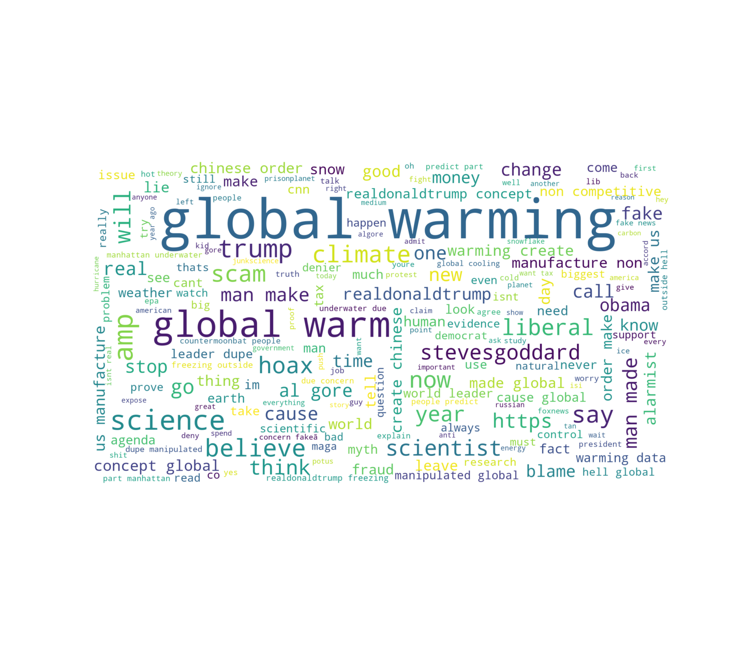
Generating the word cloud image from Negative Messages

Slide 21
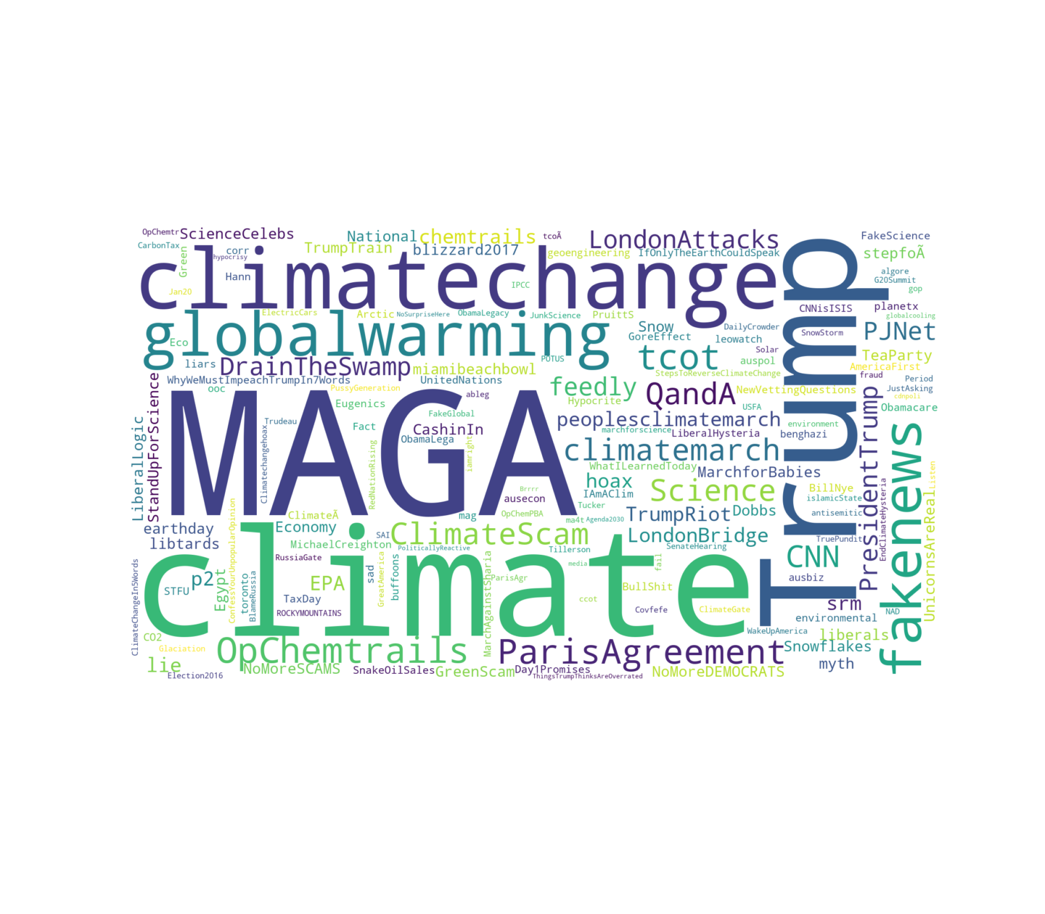
Generating the word cloud image from Negative Hashtags

Slide 22
FEATURE ENGINEERING
Feature Extraction
Converting the collection of clean messages to a matrix of token counts
Converting the collection of clean messages to a matrix of TF-IDF features
Using sparse to train the model using both representations.

Slide 23
Modelling
Training with imbalanced data
Splitting the previously defined features and label of your dataset
Creating a list of all the models to train
Fitting models onto the training data and predicting.
Best preforming models
LogisticRegression
SVC

Slide 24
Balancing the classes
Class size to up/down sample
Separating the four classes
Up-sampling
Up sampling classes 1, 2, and 4 & down sampling class 3
Creating a new DataFrame out of the balanced data

Slide 25
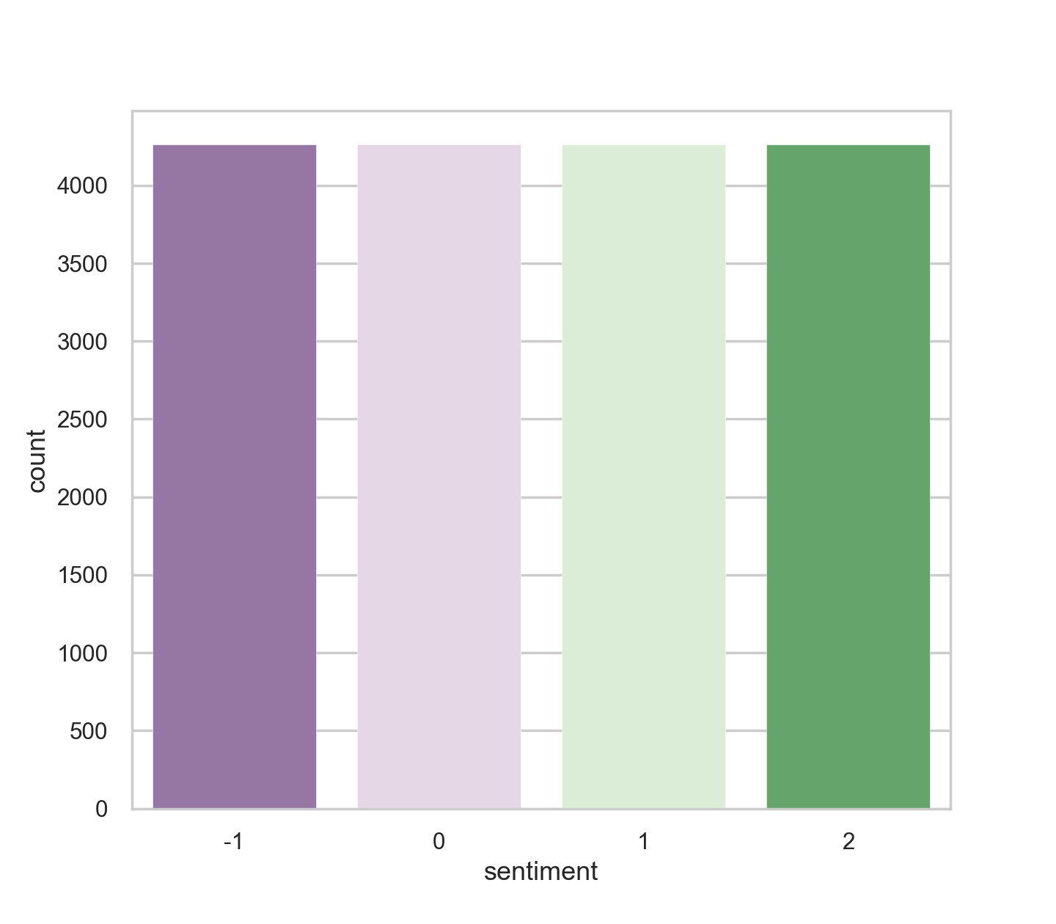
Checking if data has been well-balanced

Slide 26
Training with balanced data
Defining the features as well as the label
Fitting models onto the training data and predicting.
Best performing models
Most of the models scored F1_score above 0.80
LogisticRegression()
SVC()
Multinomial()
RandomForestClassifier()

Slide 27
Conclusions
Accuracy is not always the best metric to use when evaluating imbalanced datasets as it can be very misleading.
There are possibilities of obtaining better results using Parameter Tuning, and better preprocessing techniques. We commit to continue to conduct research into discovering models that would yield optimal results.
These insights will be useful in providing stakeholders that are interested in climate change understand the distribution of sentiments around the issue"

Slide 28
ACKNOWLEDGEMENTS AND REFERENCES
Explore DataScience Academy
Project supervisor
Simon Shilo
Pod leaders
Ebrahim Noormahomed,
https://machinelearningmastery.com/how-to-reduce-overfitting-with-dropout-regularization-in-keras/
https://machinelearningmastery.com/use-dropout-lstm-networks-time-series-forecasting/
https://machinelearningmastery.com/use-dropout-lstm-networks-time-series-forecasting/
https://www.youtube.com/watch?v=SEnXr6v2ifU

Slide 29


